Slide 1
SHRINIK HACKATHON TEAM: CODE_BREAKERS
TEAM MEMBERS
Udit Mishra
Nishant Gupta
Nikhil Kumar
Prakhar Kumar

Slide 2
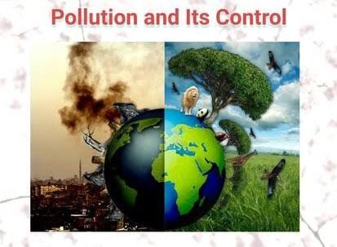
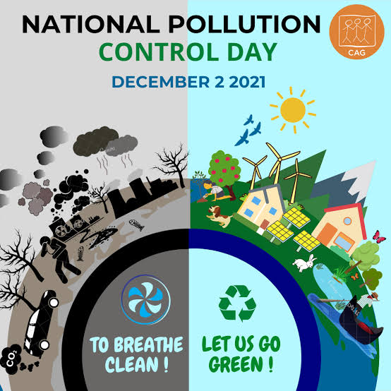
POLLUTION CONTROL
Pollution is nothing but the resources we are not harvesting .
We allow the to disperse because we have been ignorant of their value .

Slide 3

OVERVIEW
POLLUTION –
introduction of contaminants in to the environment that cause harm or discomfort to humans or other living organisms or "that damages the environment which can come in the form of chemical substances or energy such as noise , heat or light.
ENVIRONMENTAL POLLUTION-
"The contamination of physical and biological components of the earth/atmosphere system to such an extent that normal environmental processes are adversely affected."

Slide 4
AIR POLLUTION
Q. WHAT IS AIR POLUTION ?
Air pollution is contamination of the indoor or outdoor environment by any chemical, physical or biological agent that modifies the natural characteristics of the atmosphere.
Household combustion devices, motor vehicles, industrial facilities and forest fires are common sources of air pollution. Pollutants of major public health concern include particulate matter, carbon monoxide, ozone, nitrogen dioxide and sulfur dioxide. Outdoor and indoor air pollution cause respiratory and other diseases and are important sources of morbidity and mortality.

Slide 5
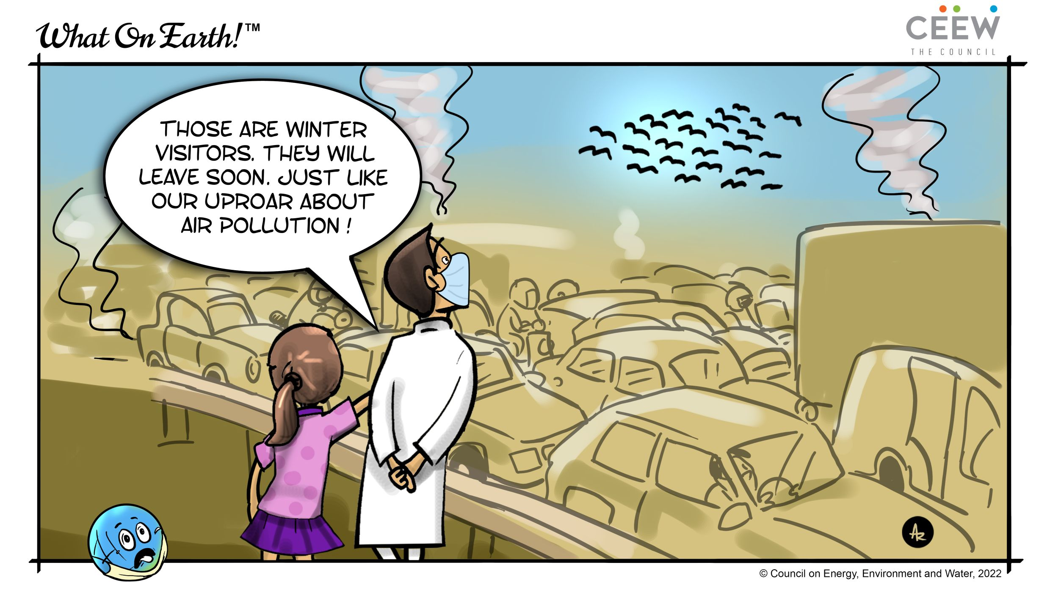
WHAT ARE THE MAIN CAUSE OF AIR POLLUTING
Carbon dioxide-this happens because of Deforestation and fossil fuel burning.
Sulfur dioxide –Due to the burning of sulfur containing compounds of fossil fuels.
Sulfur oxides- very dangerous to humans at a high concentration. Sulfur in the atmosphere is responsible for acid rain.

Slide 6
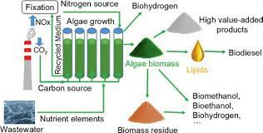
AQI (AIR QUALITY INDEX)
The Air Quality Index (AQI) is used for reporting daily air quality. It tells you how clean or polluted your air is, and what associated health effects might be a concern for you. The AQI focuses on health effects you may experience within a few hours or days after breathing polluted air. EPA calculates the AQI for five major air pollutants regulated by the Clean Air Act: ground-level ozone, particle pollution (also known as particulate matter), carbon monoxide, sulfur dioxide, and nitrogen dioxide. For each of these pollutants, EPA has established national air quality standards to protect public health .Ground-level ozone and airborne particles are the two pollutants that pose the greatest threat to human health in this country.

Slide 7
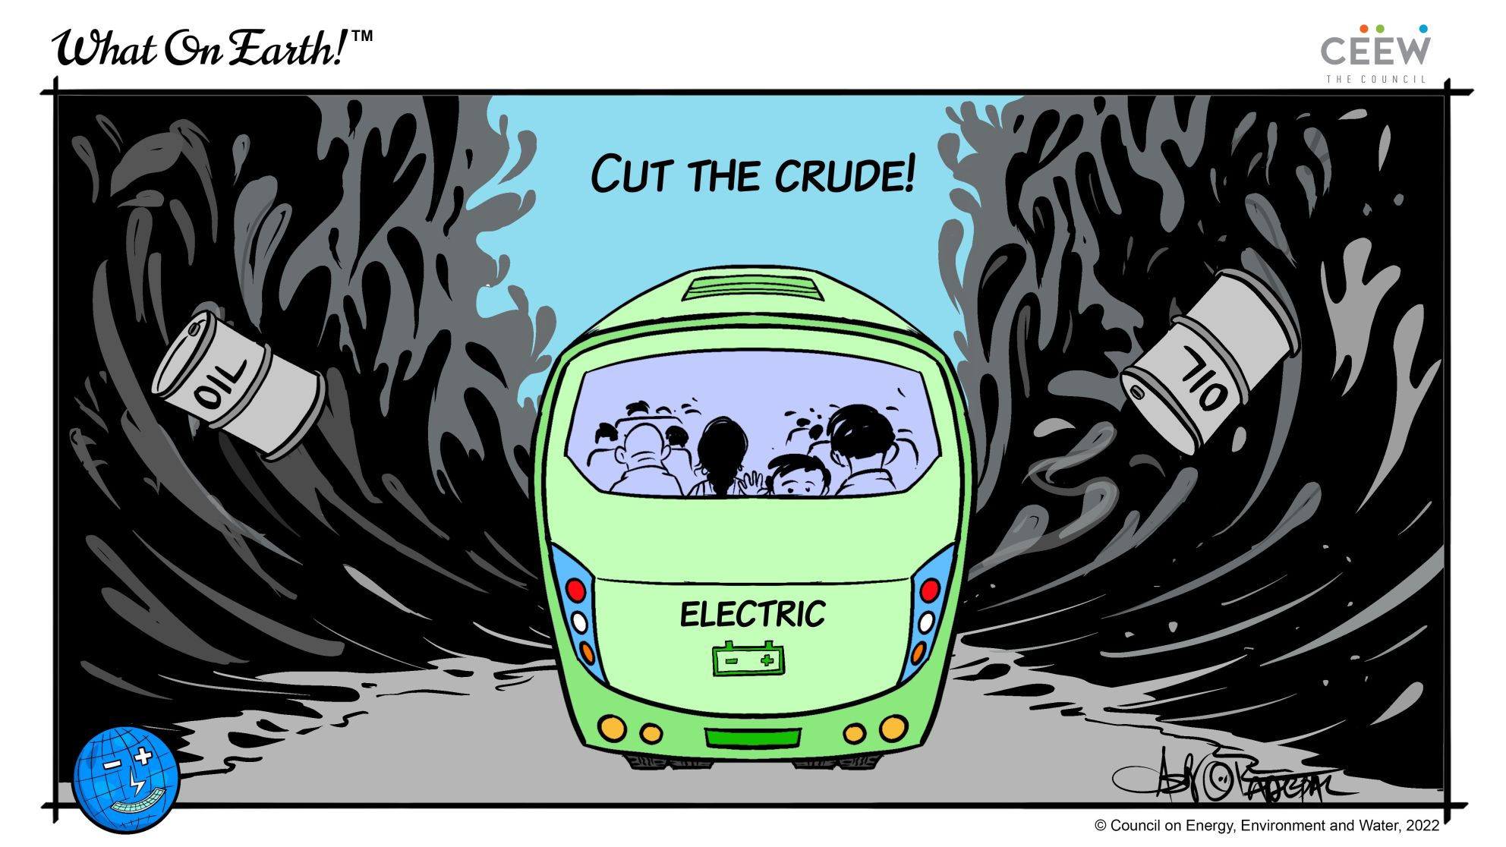
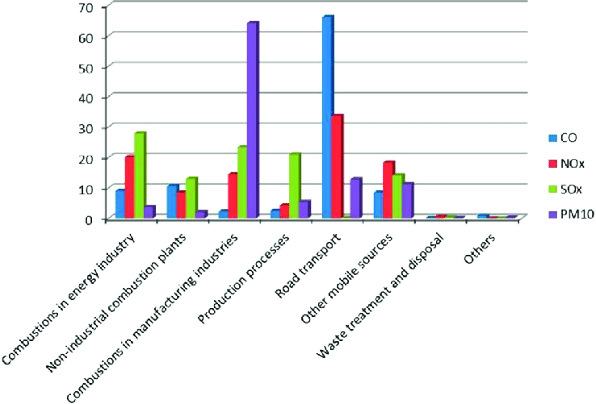
SOLUTION FOR AIR POLLUTION 1.ELECTRIC VEHICLE
Choose a cleaner commute share a ride to work or use public transportation
Corporations should include air control system to filter out smoke coming out of factories
Track and reduce your carbon footprint.

Slide 8
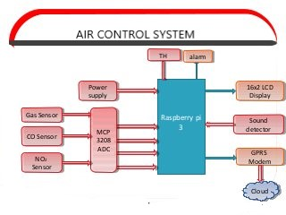
Air Control System

Slide 9
